Slide 1

IBM Data Science Capstone Project
Housing Analysis of Rockville, MD

Slide 2
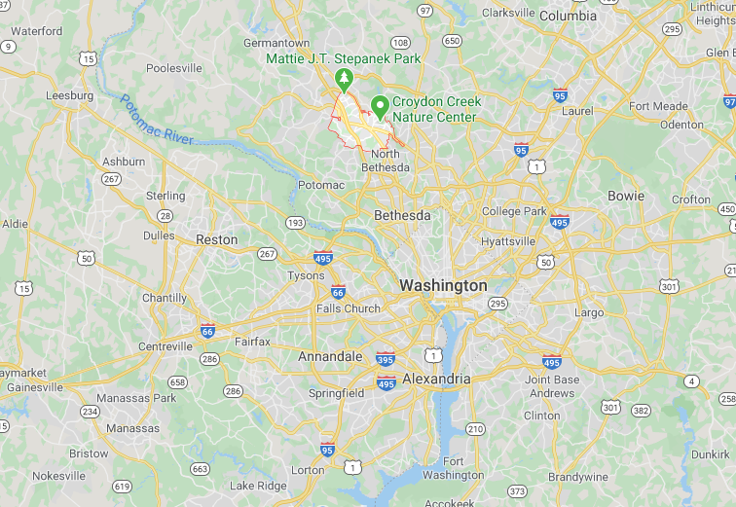
Background & Problem
Located approximately 14 miles north of Washington D.C., Rockville is home to a well-educated diverse population and serves as an employment center for national biomed corporations, the federal government and county government
Due to its rapid growth, the population of single-person households, including young people starting out in their careers has increased substantially
This project aims to provide a big picture of the housing market (i.e. price range, home conditions, etc.) of Rockville and the surrounding neighborhoods.

Slide 3
Project Interests
Analyzing the distribution of single-home housing in Rockville and its nearby neighborhoods
Determining the common features that drive housing cost
Exploring the most popular venues around the areas of interest

Slide 4
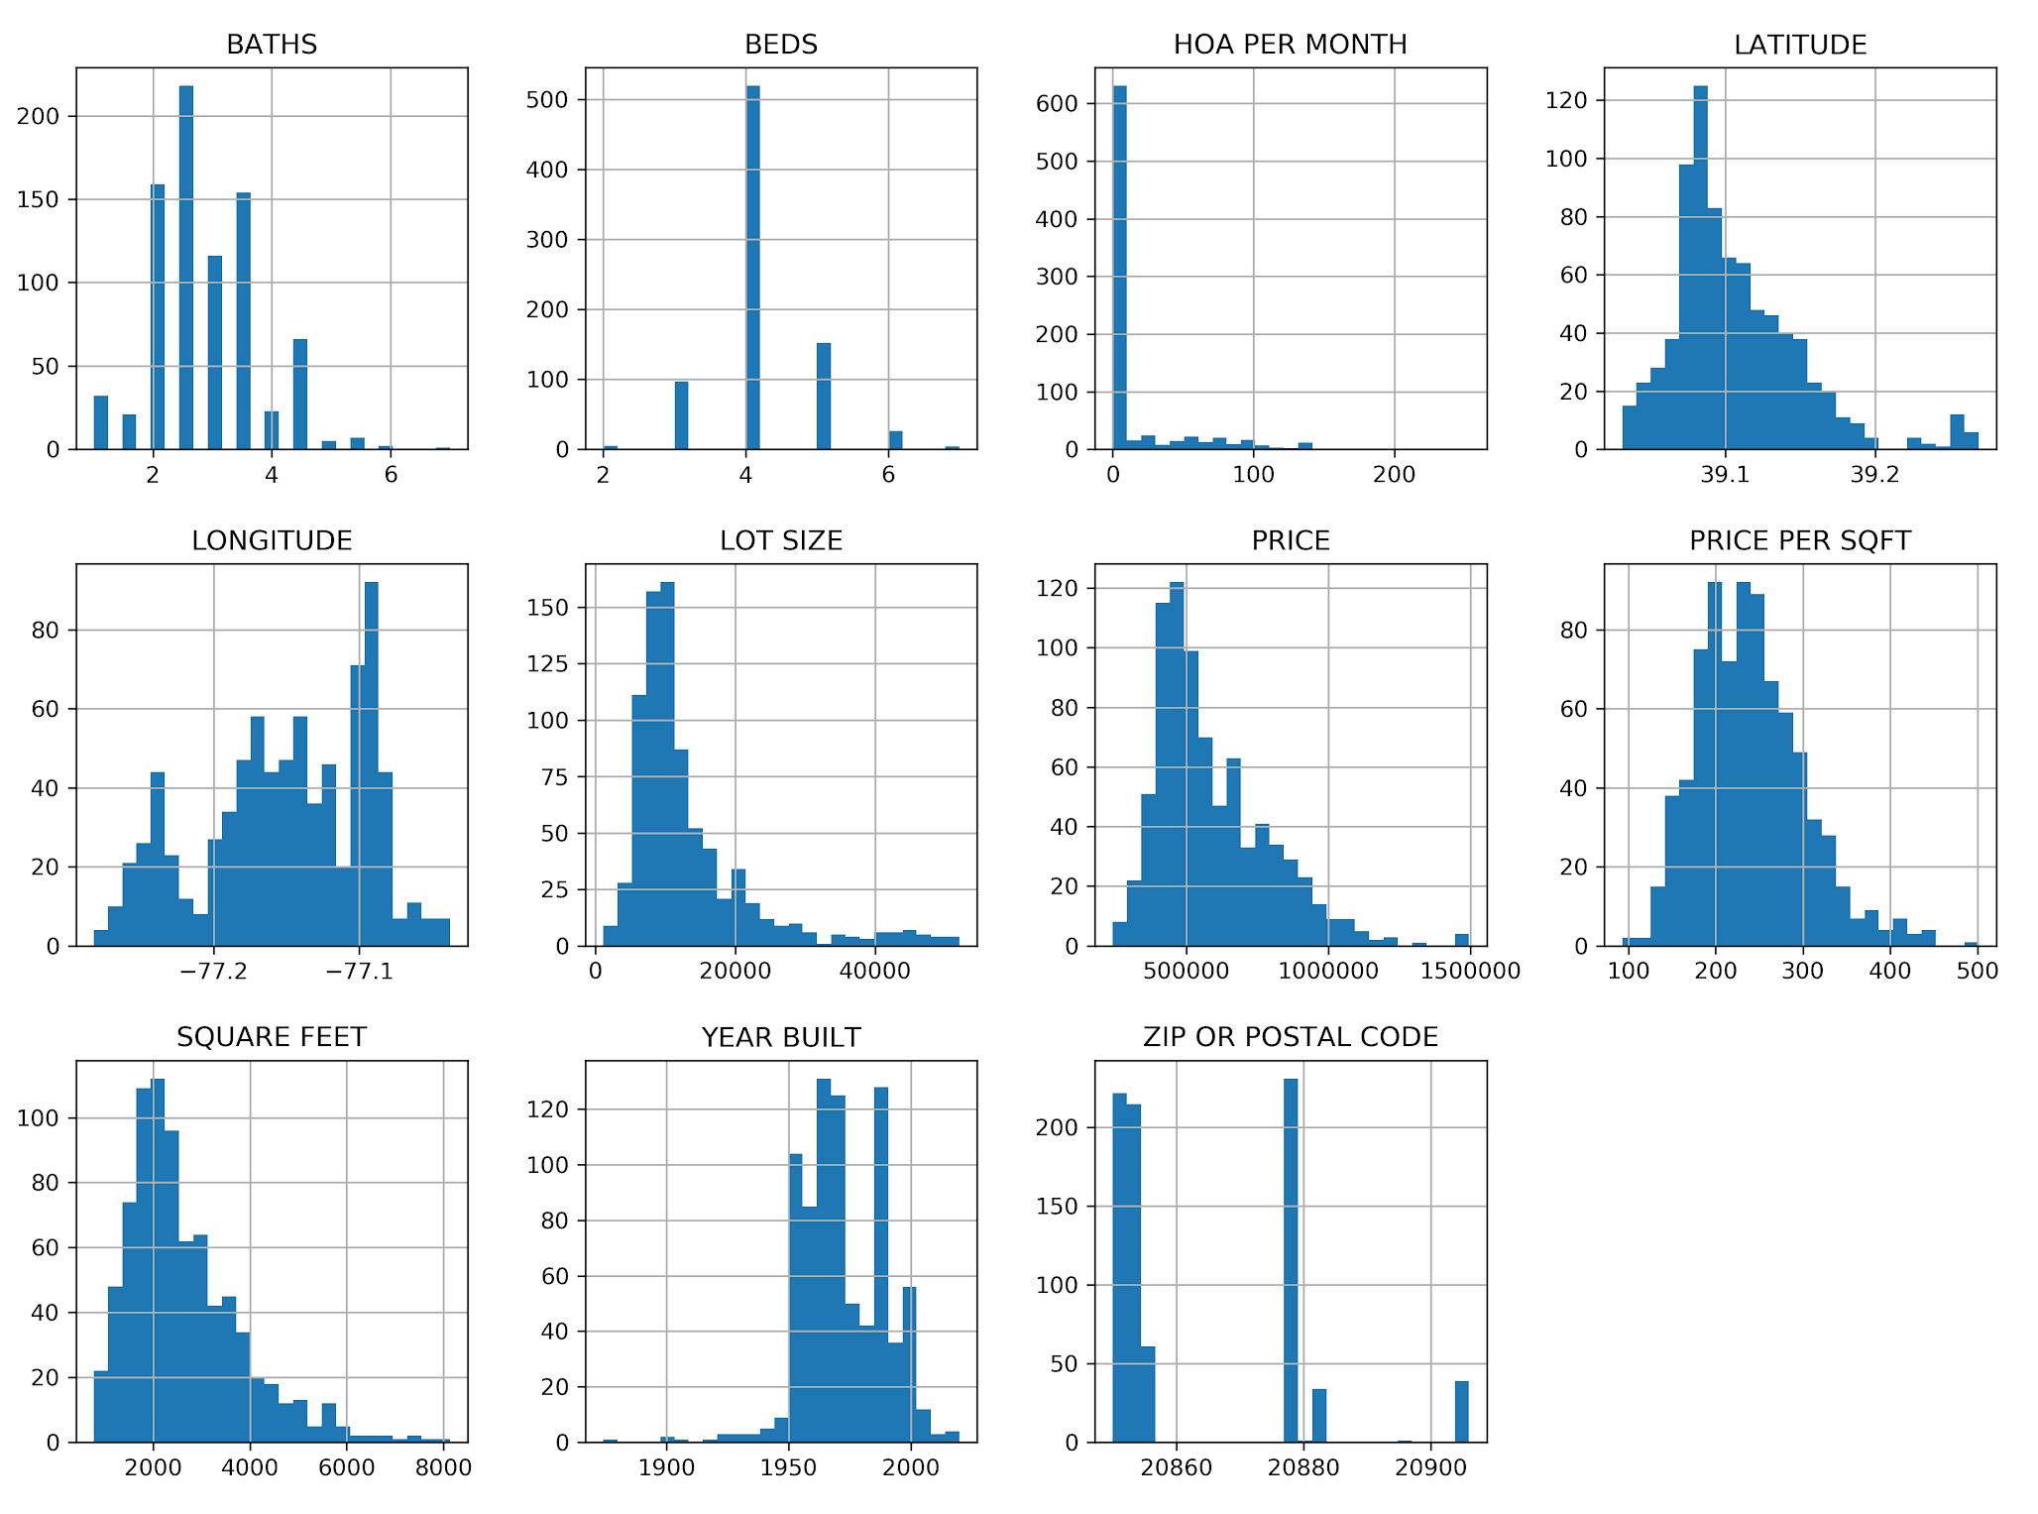
Data Acquisition & Cleaning
Filtered distribution of numerical features
Property listing data collected from Redfin (as of July 1st, 2020)
Cities including Rockville and its surrounding neighborhoods
In total, 1090 rows and 27 features in raw dataset
Duplicate and redundant features were dropped
Two methods were used to filter outliers: Six Sigma and Interquantile Range (IQR) filter

Slide 5
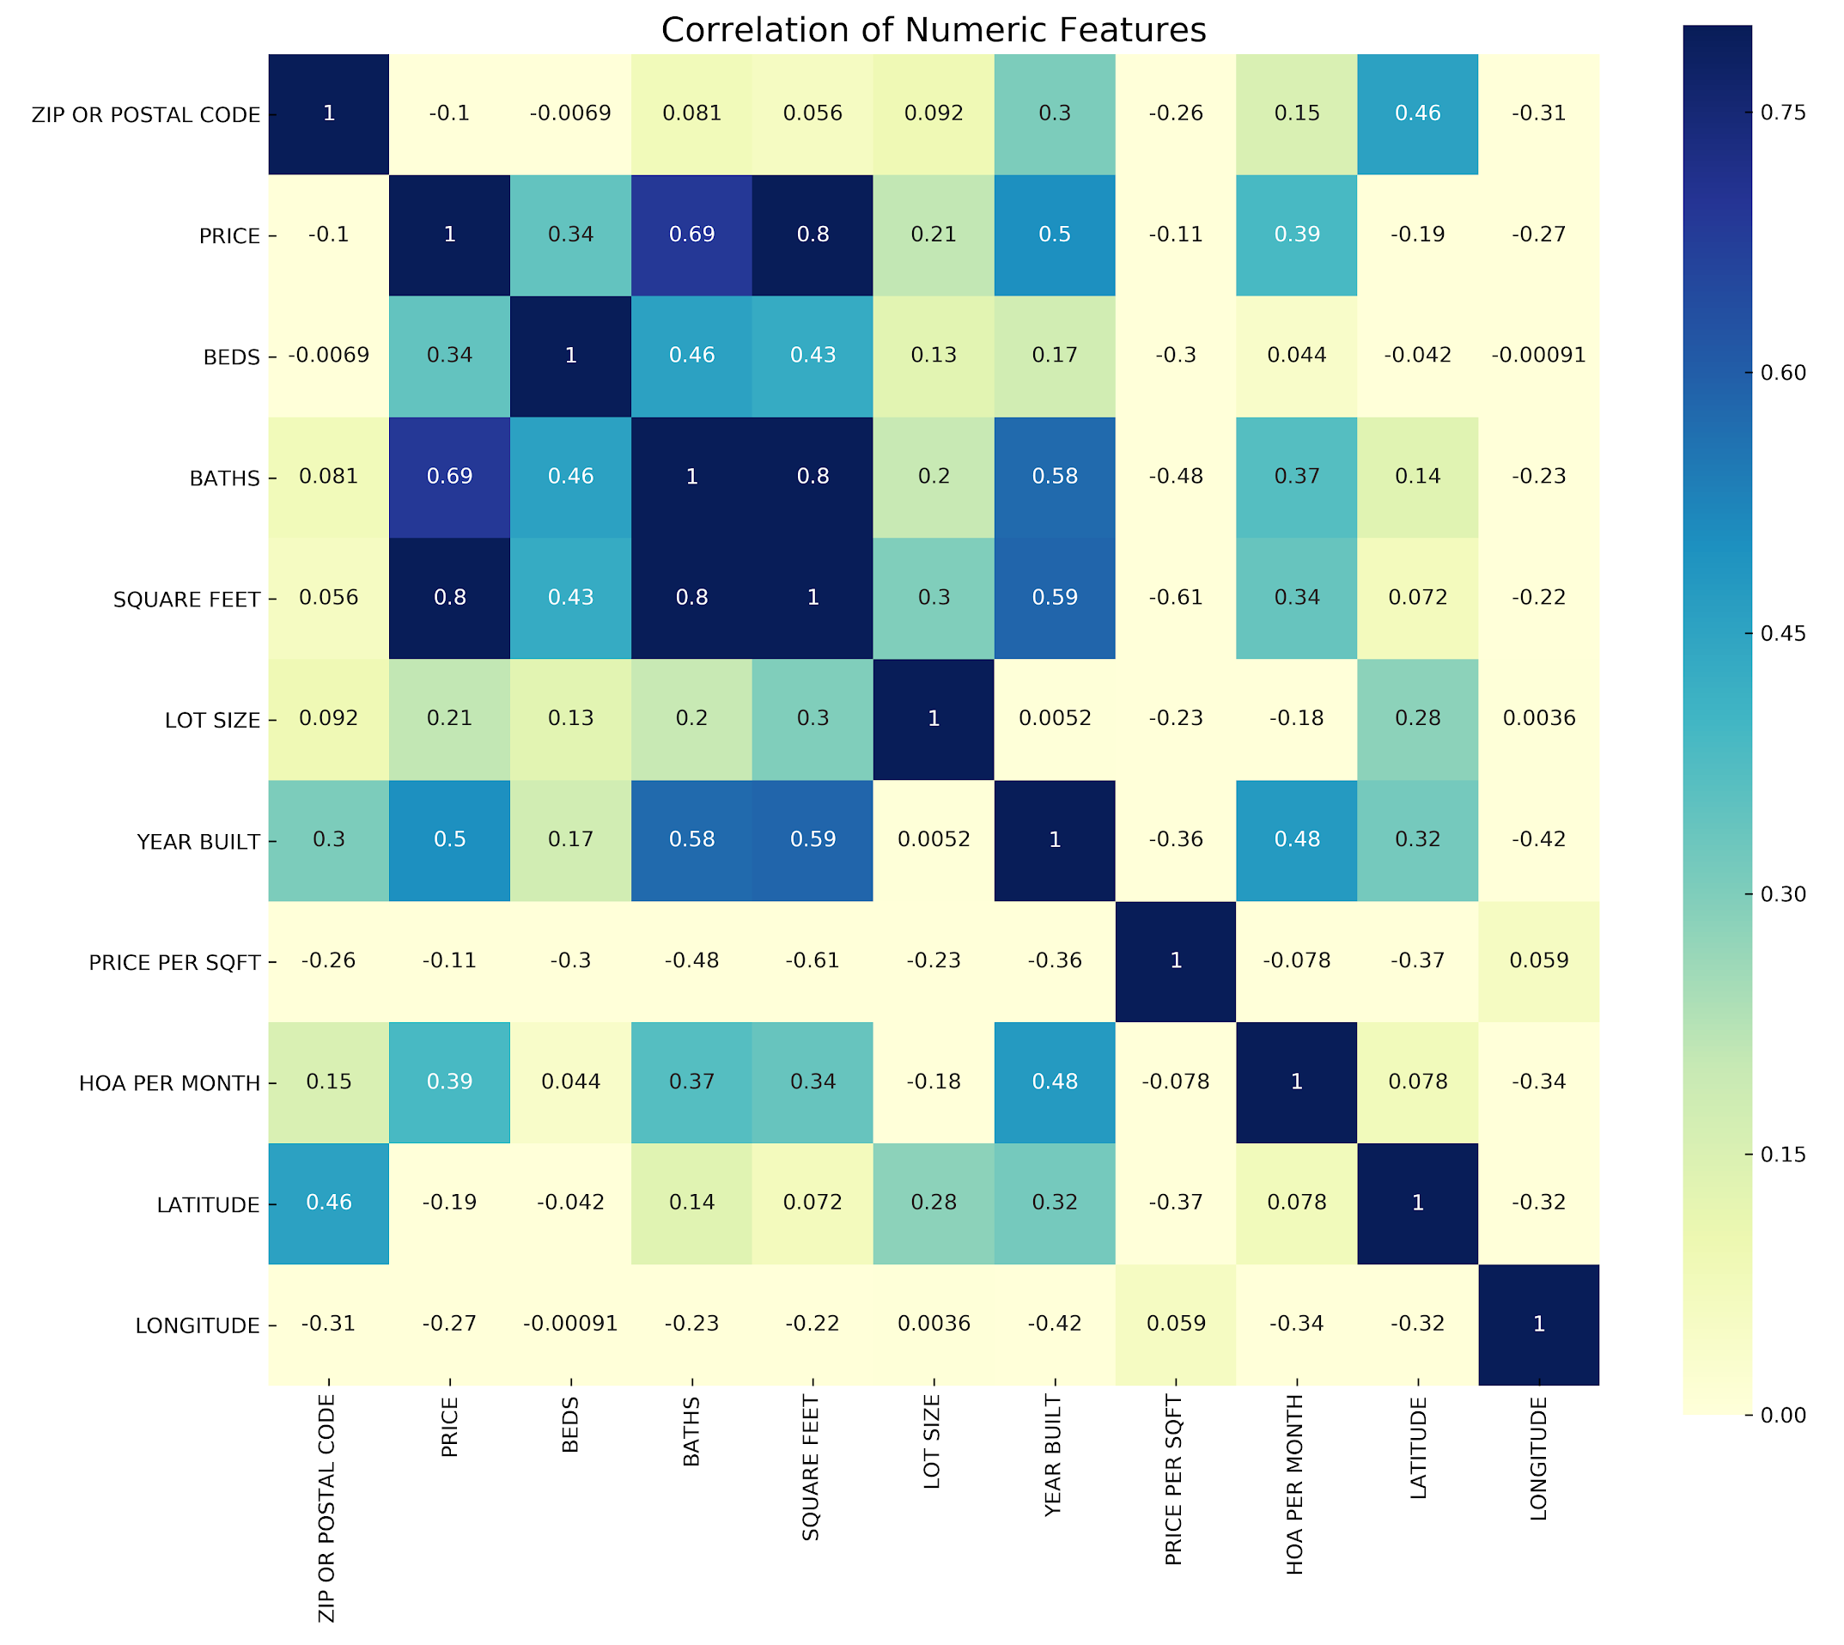
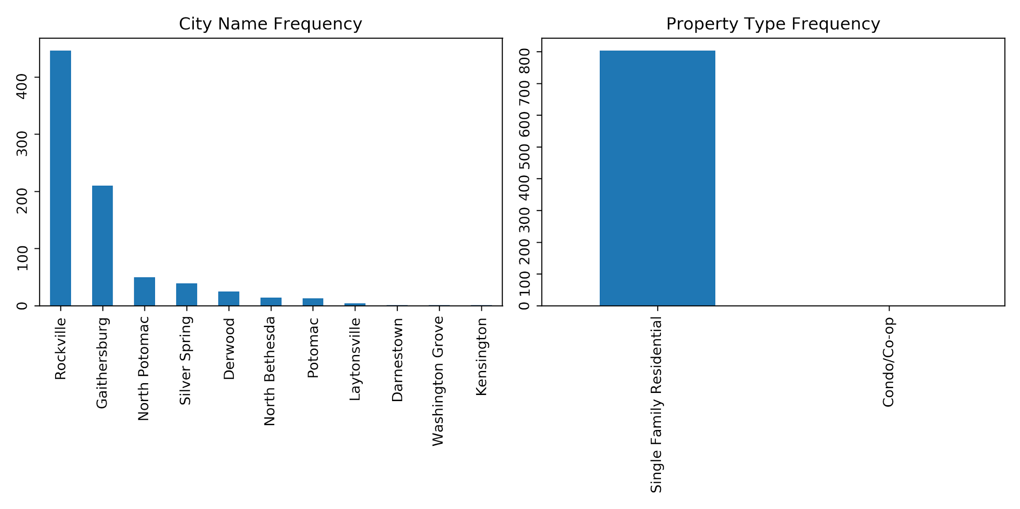
Correlation Matrix of Numeric Features

Slide 6
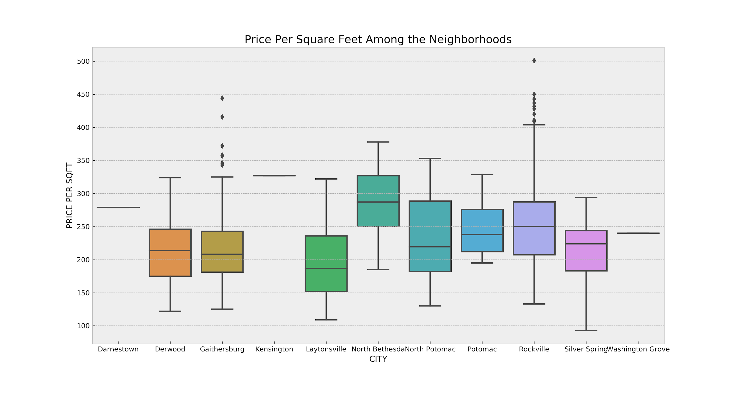
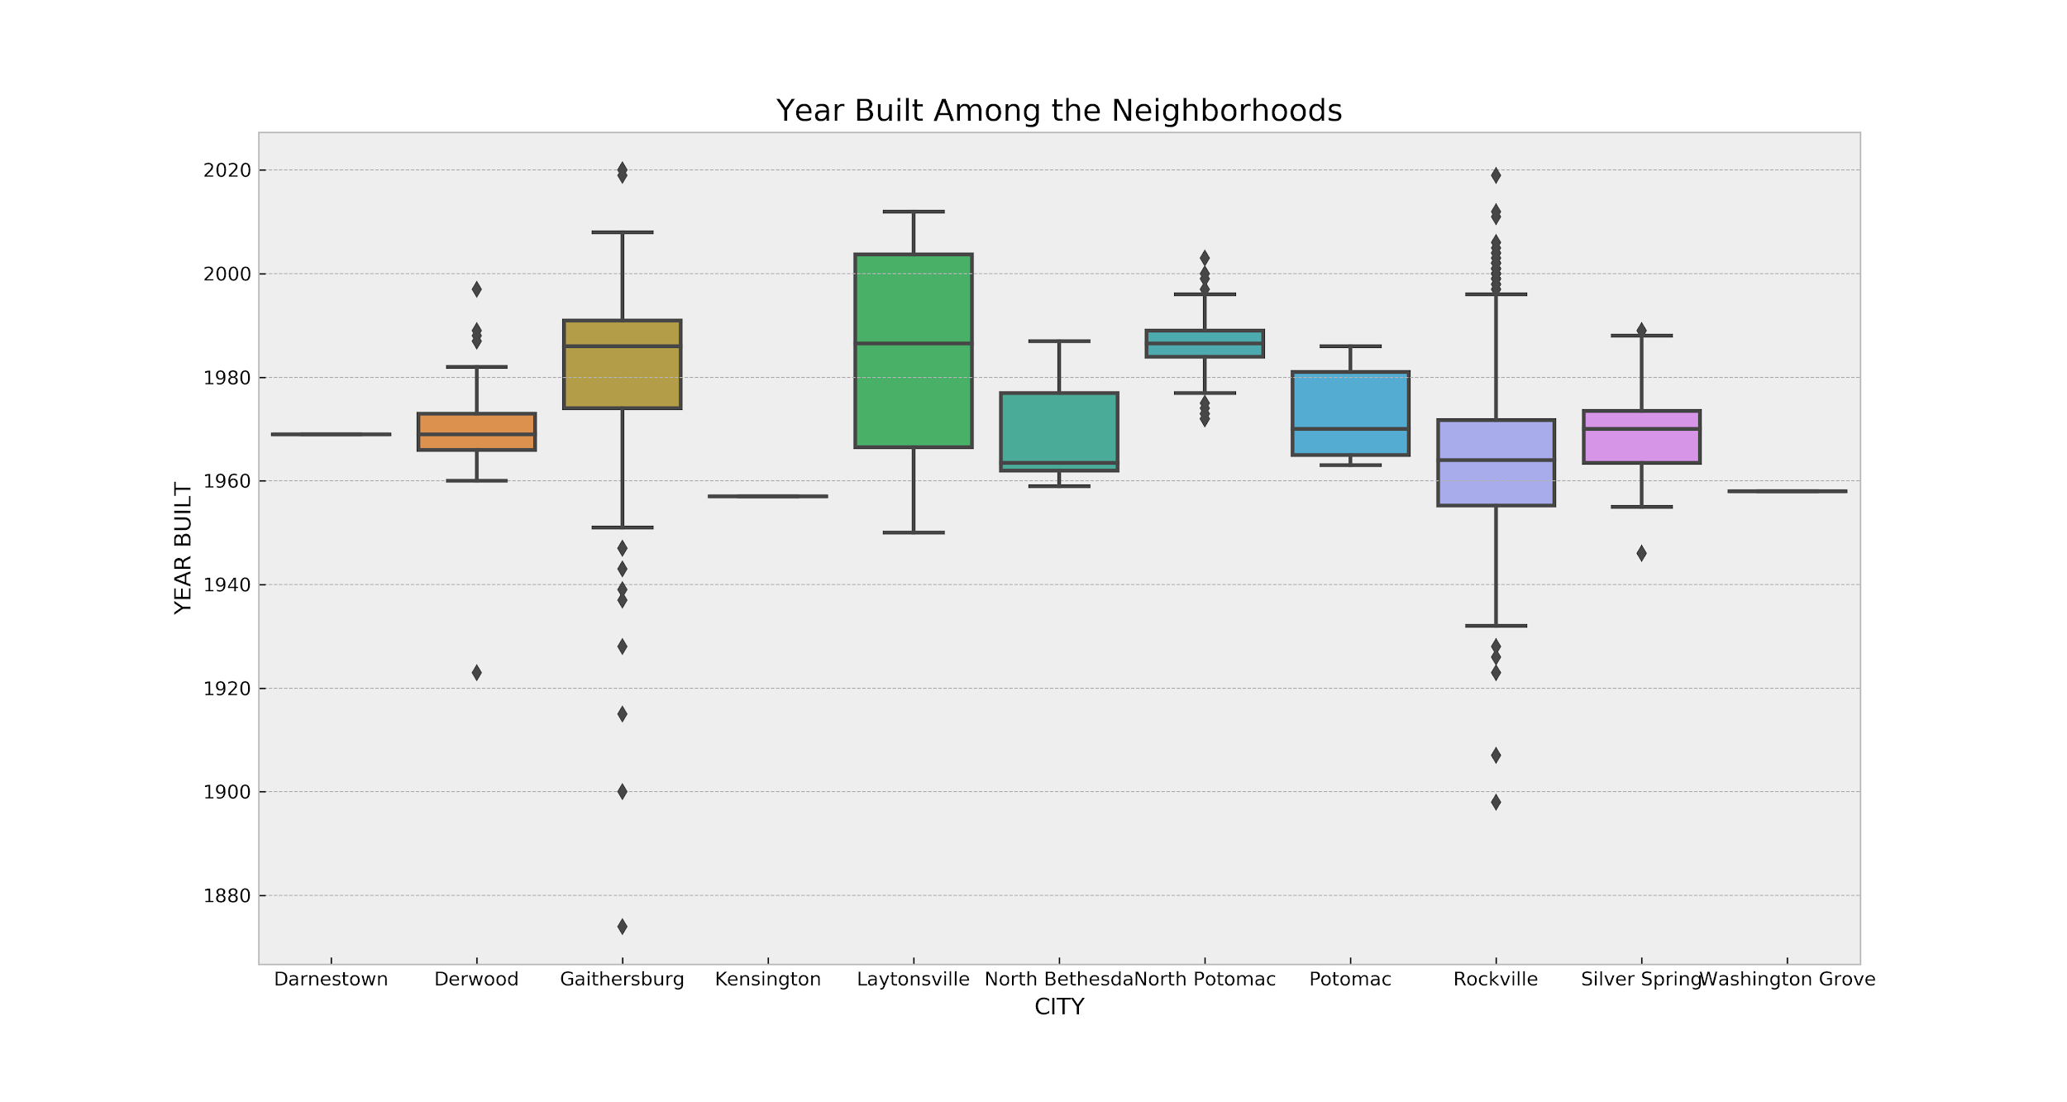
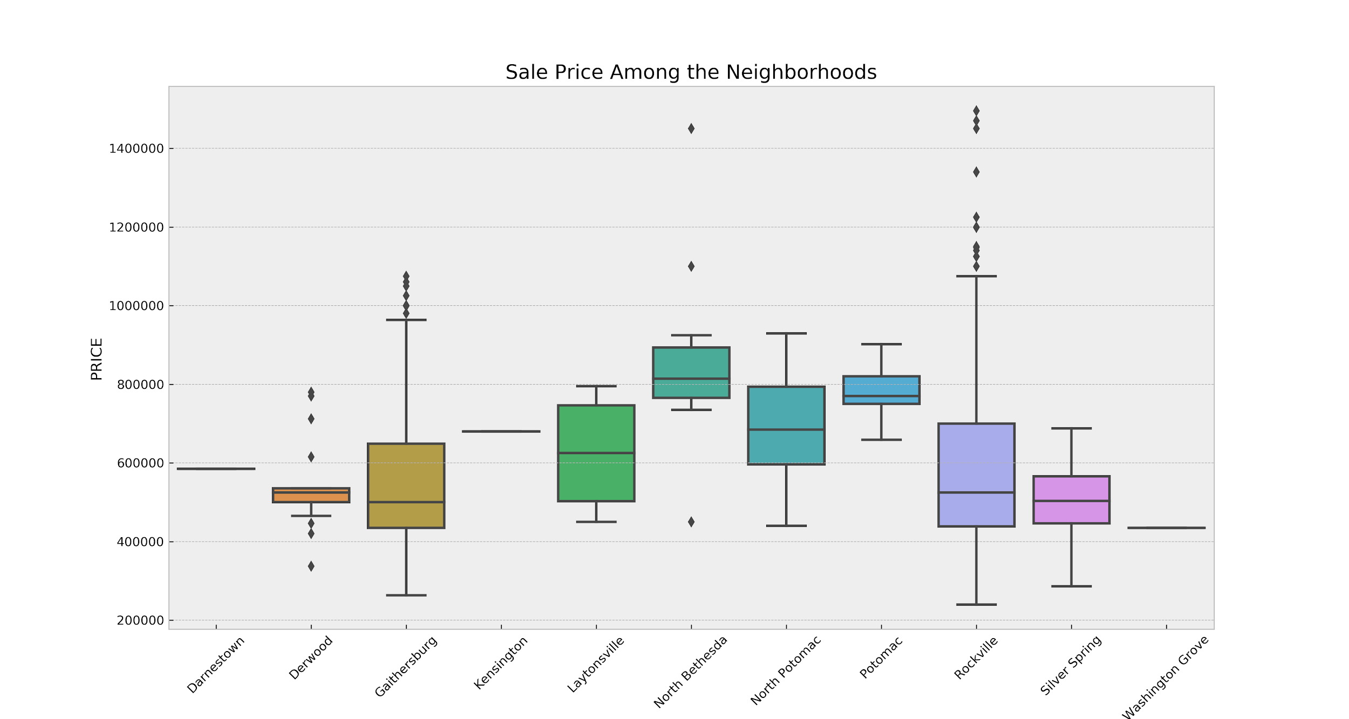
Price Variation among Neighborhoods

Slide 7
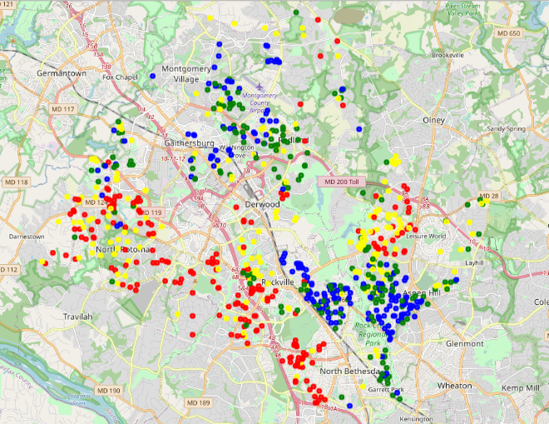
Spatial Distribution of Housing Price
Blue: Under $444,500
Green: $444,500 - $533,500
Yellow: $533,500 - $700,000
Red: Over $700,000

Slide 8
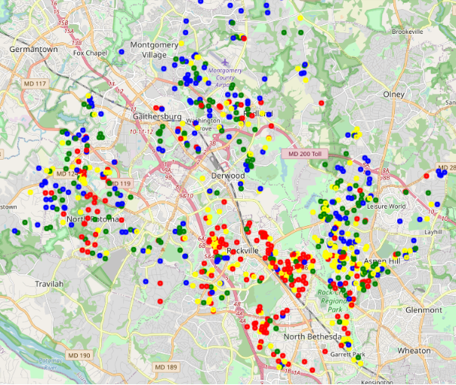
Spatial Distribution of Price Per Square Foot
Blue: Under $198
Green: $198 - $235
Yellow: $235 - $276
Red: Over $276

Slide 9
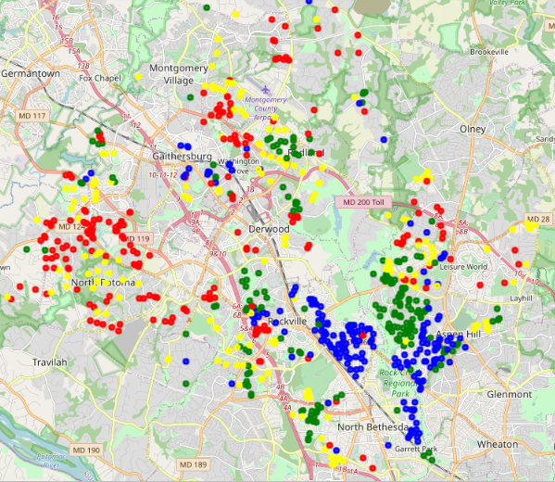
Spatial Distribution of Year Built
Blue: Before 1961
Green: 1961 - 1970
Yellow: 1970 - 1986
Red: After 1986

Slide 10
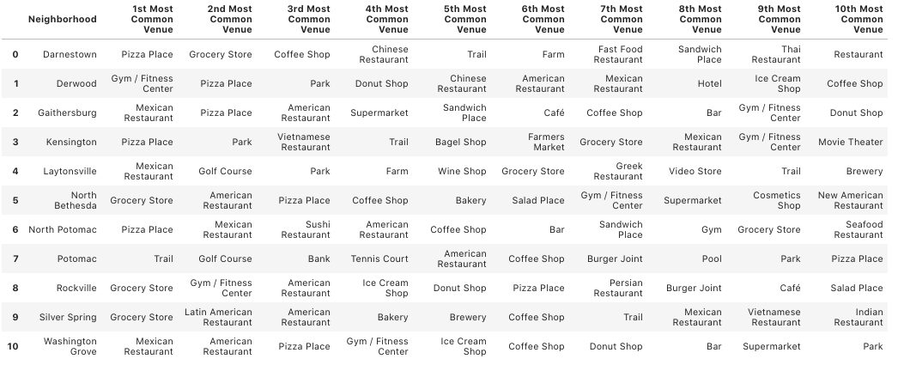
Most Common Venues of Each Neighborhood

Slide 11
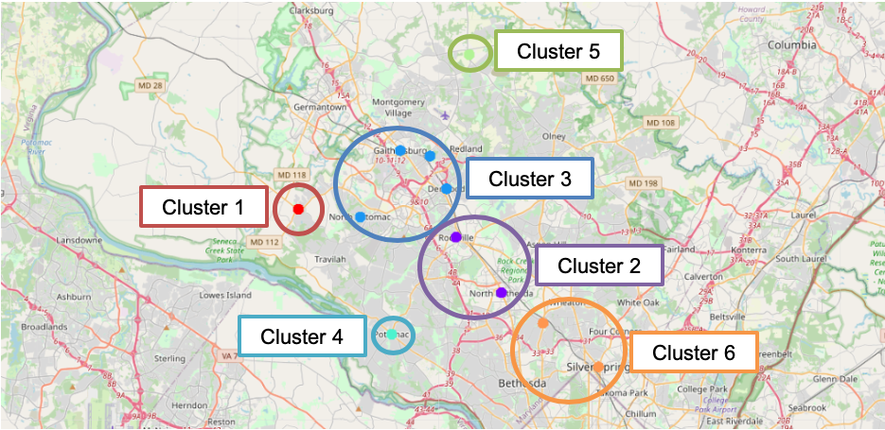
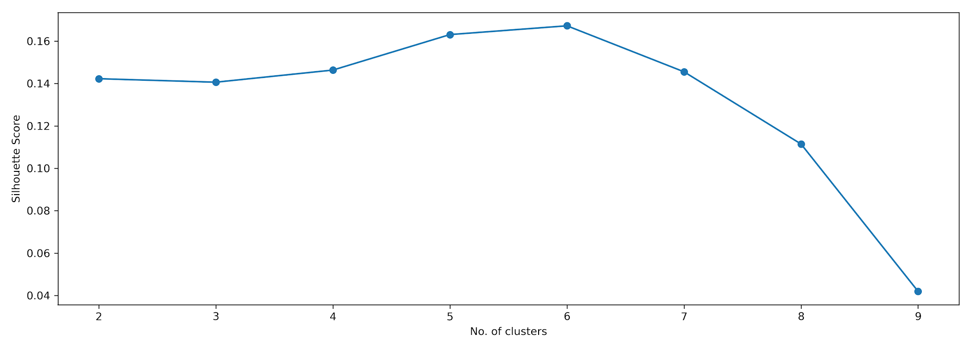
Clusters of Venues

Slide 12
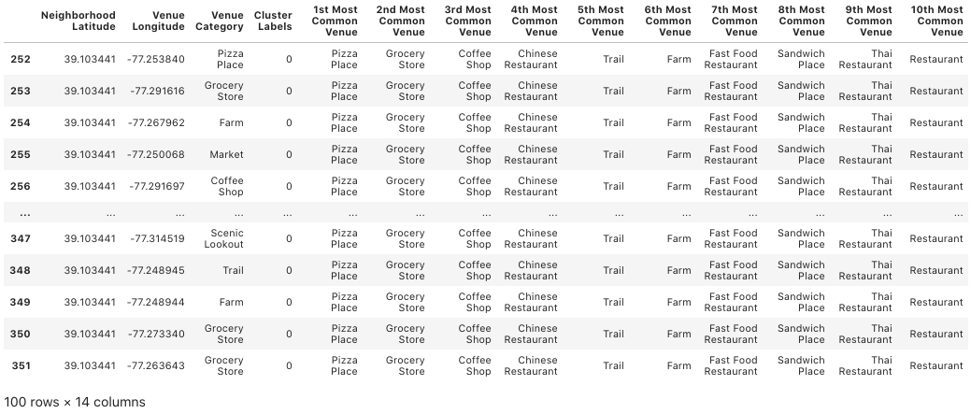
Cluster 1

Slide 13
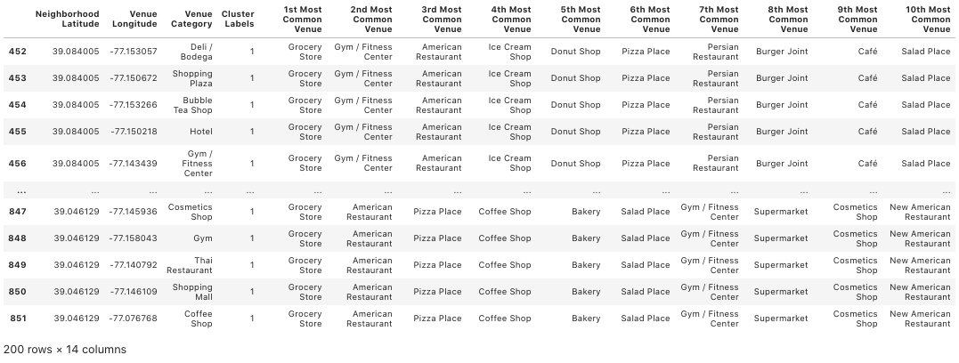
Cluster 2

Slide 14
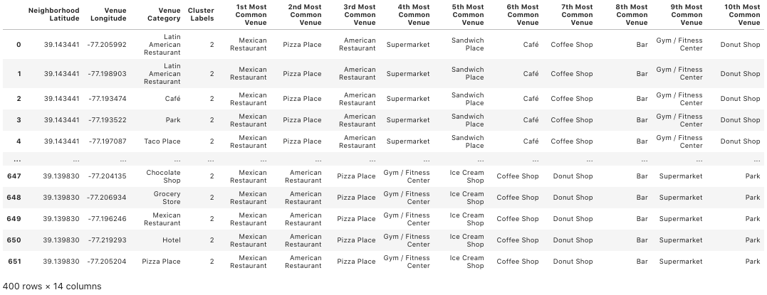
Cluster 3

Slide 15
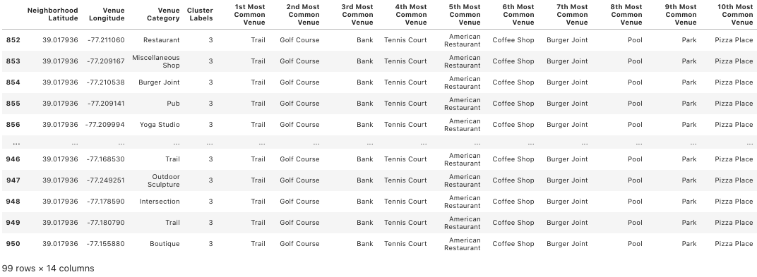
Cluster 4

Slide 16
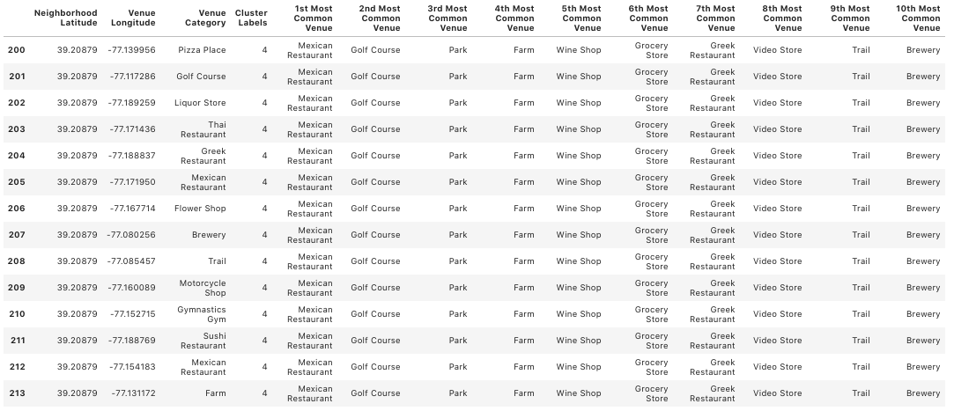
Cluster 5

Slide 17
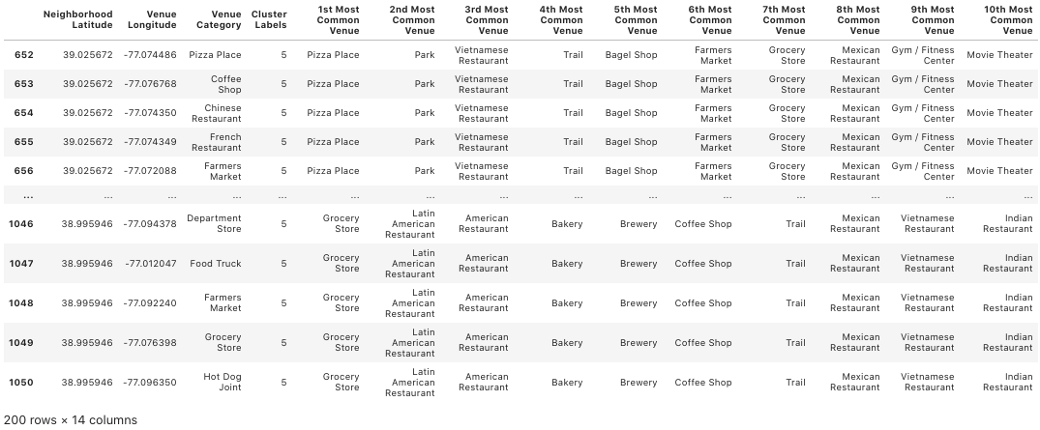
Cluster 6

Slide 18
Conclusion & Future Directions
Analyze and produce useful insights of the housing market of Rockville, MD
Accuracy of the models has room for improvement
Incorporate Crime data and Public School Rating data

